Slide 1

EIS COURSE PROJECT
Title :-Helmet and Number Plate Detection
Guided By:- Mr. Sunil V.G
Team Members-
]
NAME | ROLL NO | USN
Pratham Shirol | 117 | 01FE21BCI018
Girish D | 140 | 01FE21BCI047
Ankur | 159 | 01FE21BCI025
Shravan | 160 | 01FE21BCI023

Slide 2
Introduction
The rapid increase in the number of two-wheeler vehicles has significantly contributed to the challenges faced by traffic management and law enforcement agencies. Ensuring the safety of riders is paramount, and wearing helmets is compulsory for this purpose. Helmets provide crucial protection and significantly reduce the risk of severe injuries in case of accidents. Despite strict regulations, many riders violate these rules by not wearing helmets, posing a serious risk to their safety and endangering others. To address this issue, automated systems for helmet detection and number plate extraction have emerged as vital tools in enforcing traffic laws, enhancing road safety, and ensuring compliance with helmet regulations. These technologies not only help in identifying violators but also assist in creating a safer driving environment for everyone.
School of Computer Science and Engineering

Slide 3
Problem Statement
Develop an Automated System for Real-Time Detection of Helmet Usage and License Plate Recognition to Enhance Traffic Law Enforcement and Road Safety Compliance
School of Computer Science and Engineering

Slide 4
Objectives
Develop a model to detect individuals wearing and not wearing helmets on motorcycles.
Create a robust model for recognizing vehicle license plates in various conditions.
Implement Optical Character Recognition (OCR) for accurate alphanumeric extraction from license plates.
Optimize models for real-time performance on mobile devices.
Develop the Android application in Android Studio with real-time video processing capabilities.
Integrate detection and recognition models into an Android application.
Utilize Android Studio to develop and deploy the application on Android-based edge devices.
School of Computer Science and Engineering

Slide 5
Data Description
Dataset Collection: Manually collected images for helmet and number plate detection.
Total Images: 500 images.
Categories:
250 images with individuals wearing helmets.
250 images with individuals not wearing helmets.
Variability: Images include various angles and lighting conditions.
Purpose: To train and evaluate YOLOv8 models for:
Detecting helmet usage.
Recognizing number plates.
Data Annotation:We used Roboflow for data annotation.
Labels:
  Helmet
  No Helmet
  Number Plate
School of Computer Science and Engineering

Slide 6
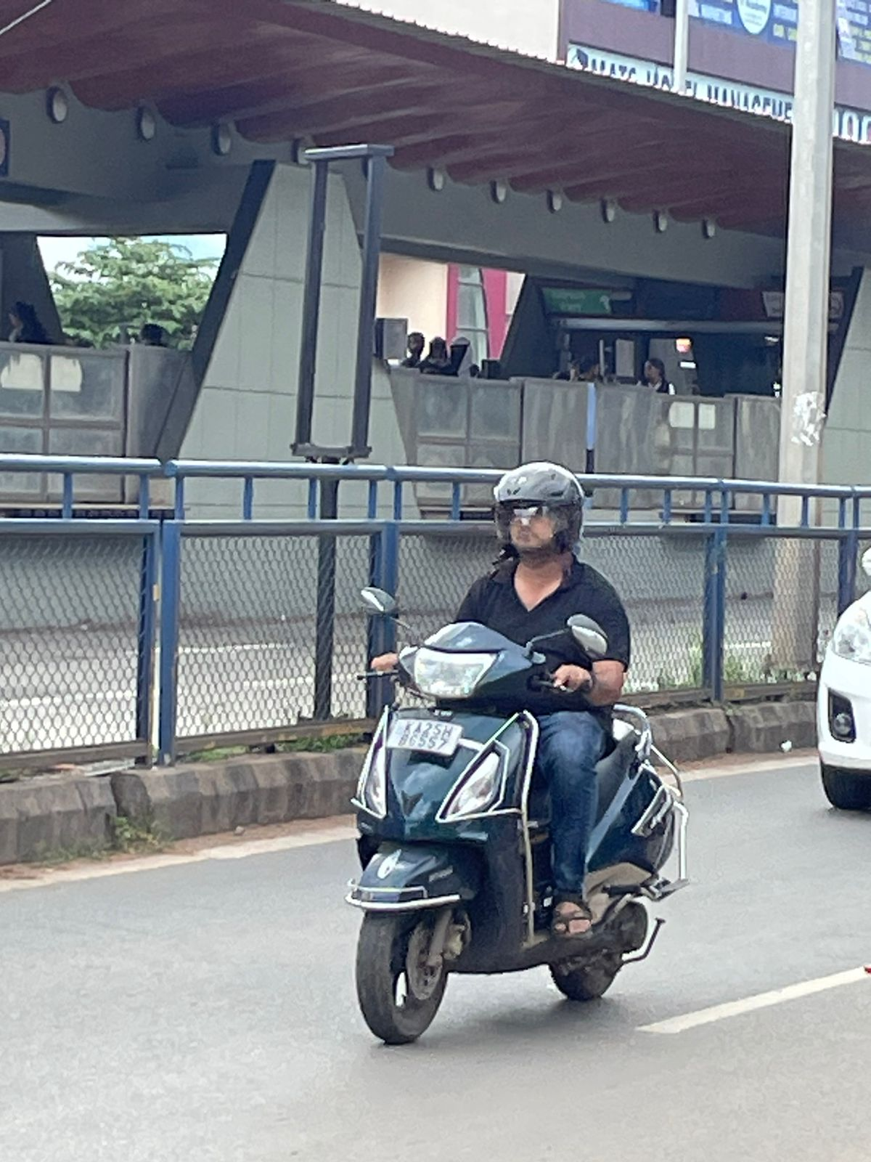
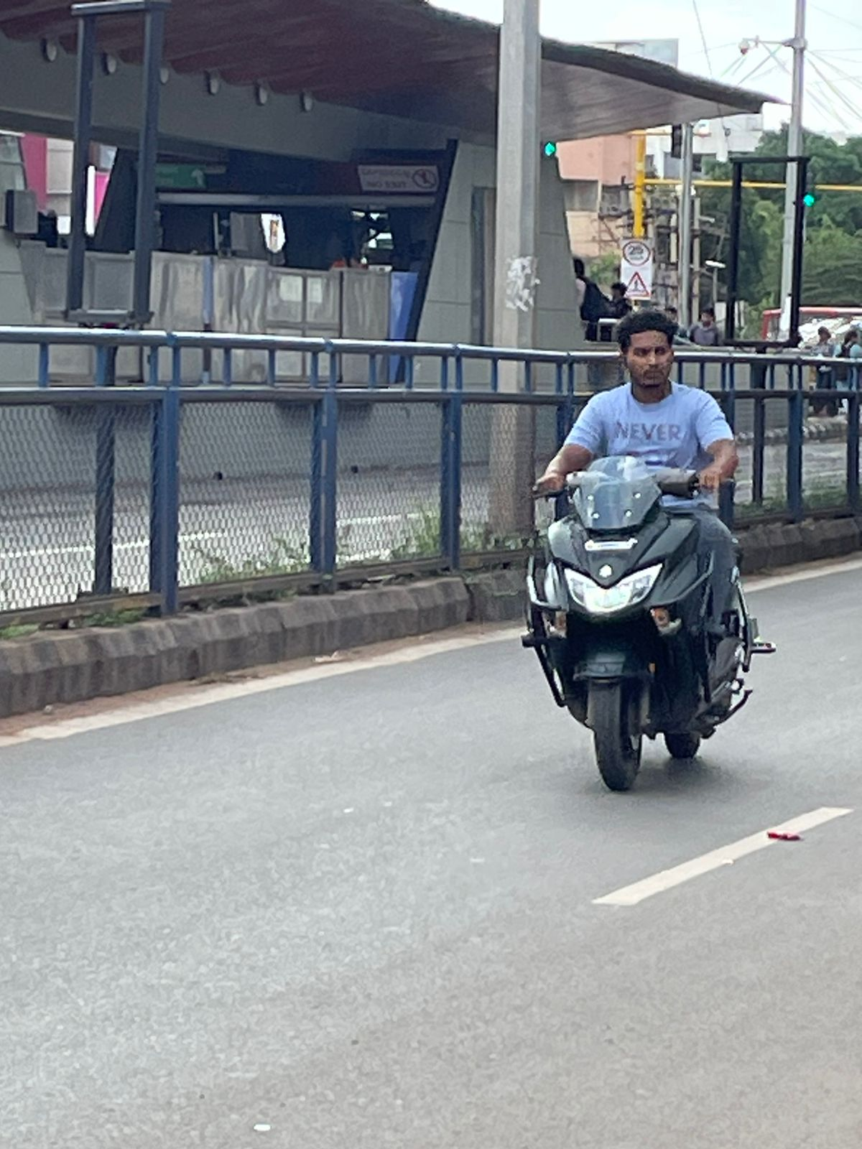
Dataset Sample
Person wearing Helmet
Person not wearing Helmet
School of Computer Science and Engineering

Slide 7
Data Agumentation and Preprocessing
Dataset Size:After augmentation and data preprocessing, the dataset size is 1200 images.
Preprocessing:The collected images were preprocessed to ensure consistency and quality.
Resizing: All images were resized to a standard dimension to maintain uniformity for model training.
Augmentation Techniques Used:
Flipping: Horizontal and vertical flips to increase variability.
Rotation: Images were rotated at various angles to simulate different perspectives.
Blurring: Applied to some images to mimic real-world conditions.
Additional Augmentations:
  Brightness adjustments
  Cropping
  Scaling
School of Computer Science and Engineering

Slide 8
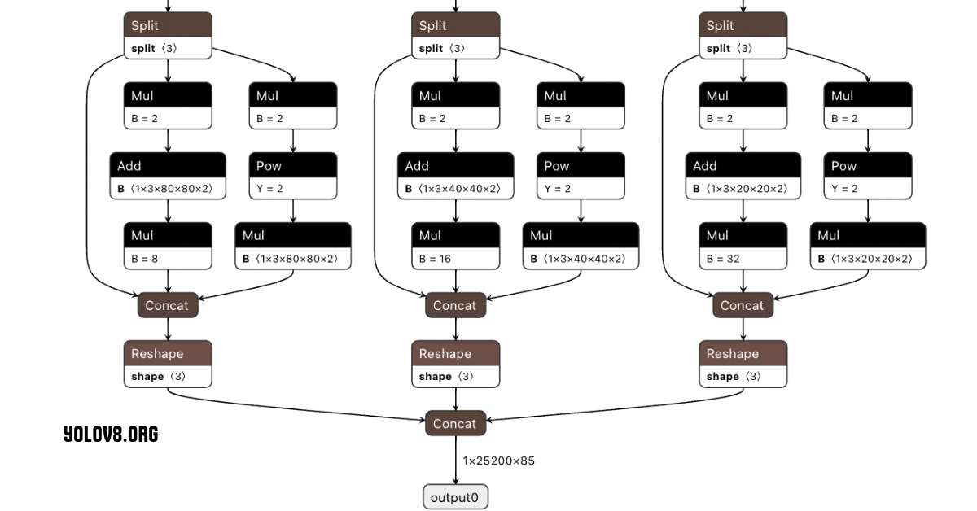
Model Used:Yolov8
School of Computer Science and Engineering

Slide 9
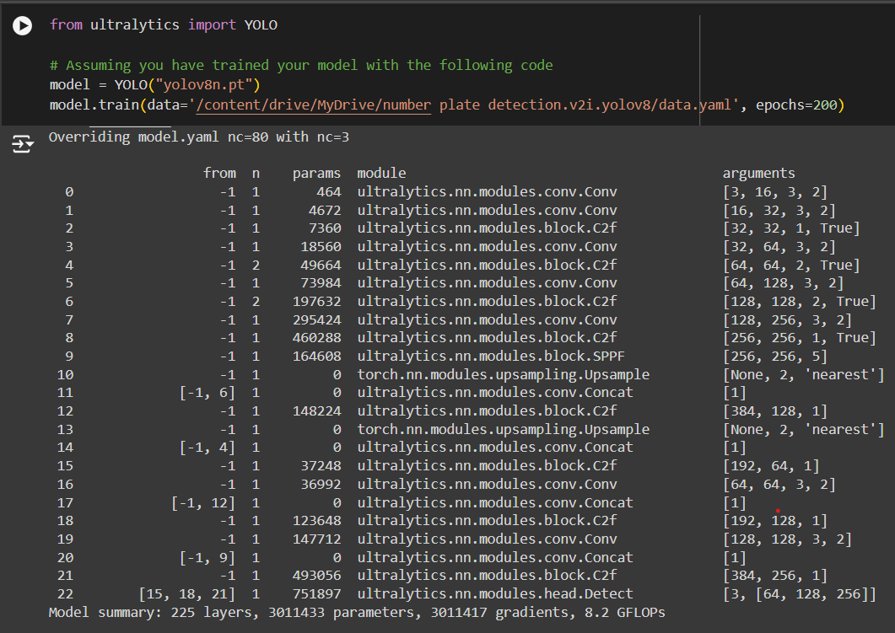
Model Training
I have trained the YOLOv8 model for helmet and number plate detection using the provided dataset. The training process was conducted with the dataset configuration file, specifying 200 epochs. The model summary indicates 225 layers, 3,011,433 parameters, and 8.2 GFLOPs.
School of Computer Science and Engineering

Slide 10
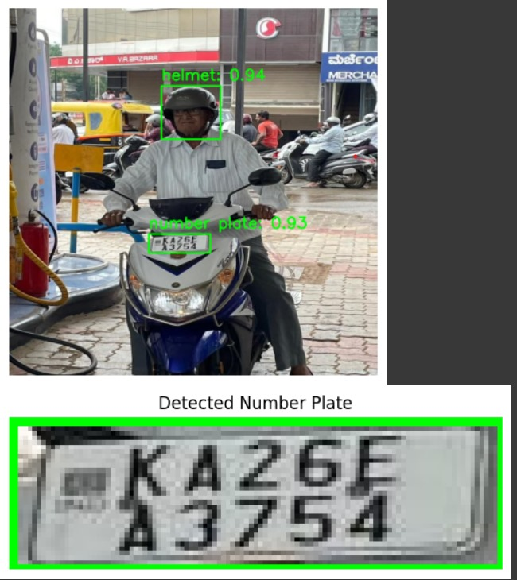
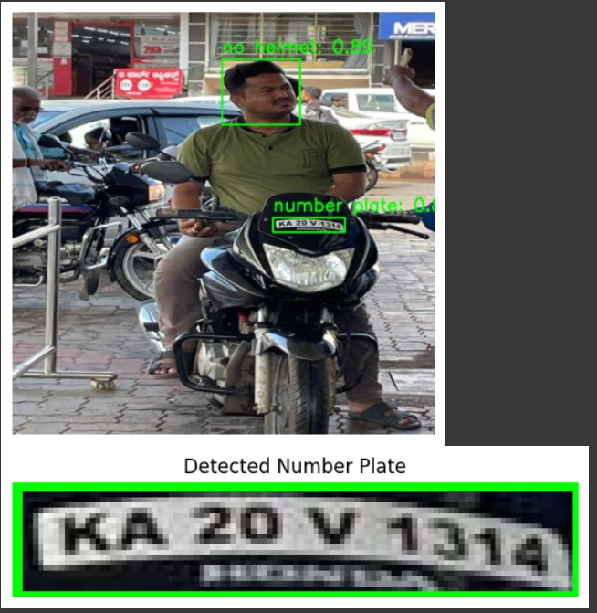
Results
School of Computer Science and Engineering

Slide 11
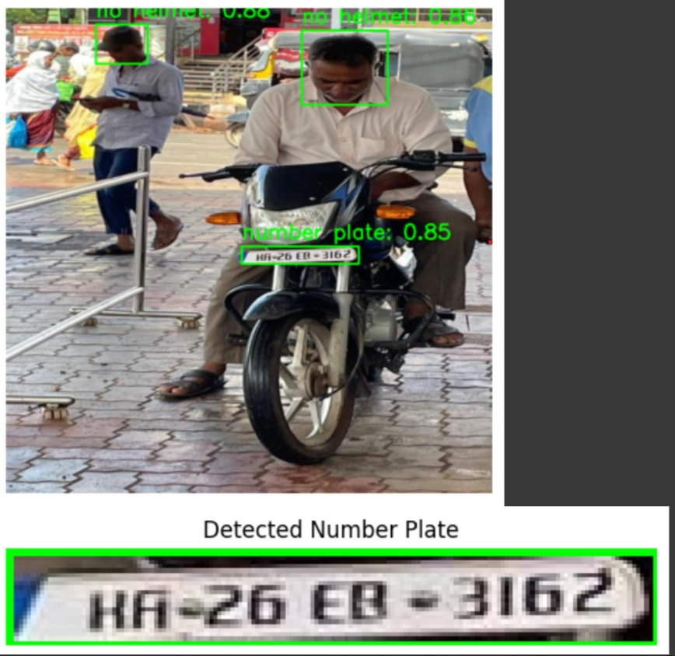
School of Computer Science and Engineering

Slide 12
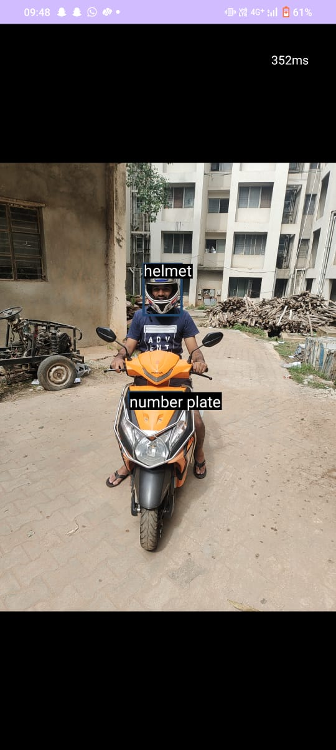
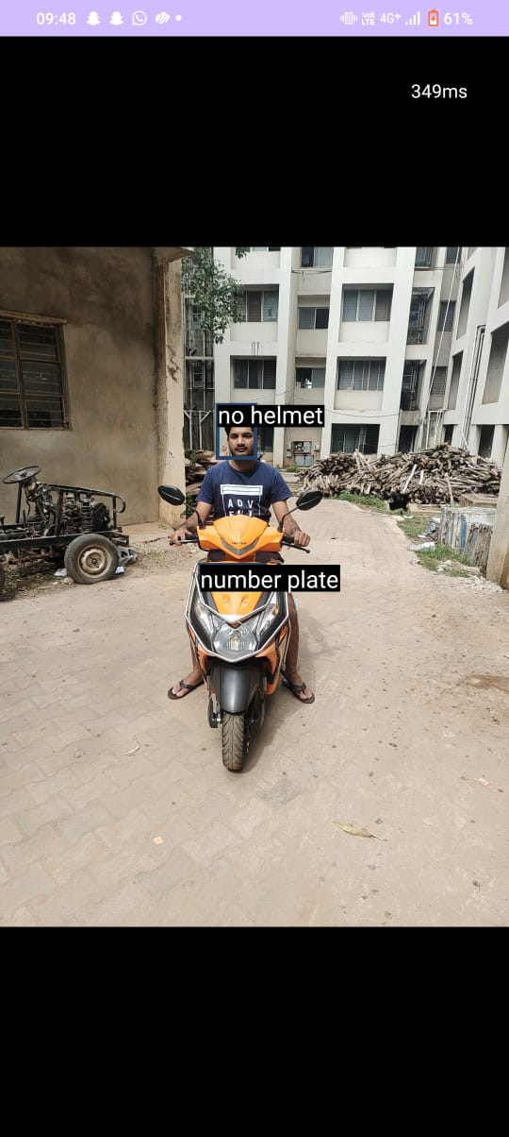
Android Studio Results
Person wearing helmet
Person not wearing helmet
School of Computer Science and Engineering

Slide 13
Thank You
School of Computer Science and Engineering

